Slide 1

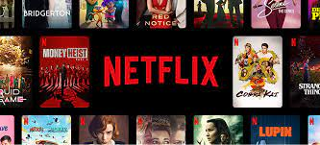
Capstone Project - 4
NETFLIX MOVIES AND TV SHOWS CLUSTERING
(Unsupervised learning)
By : Prabhat Rajput

Slide 2
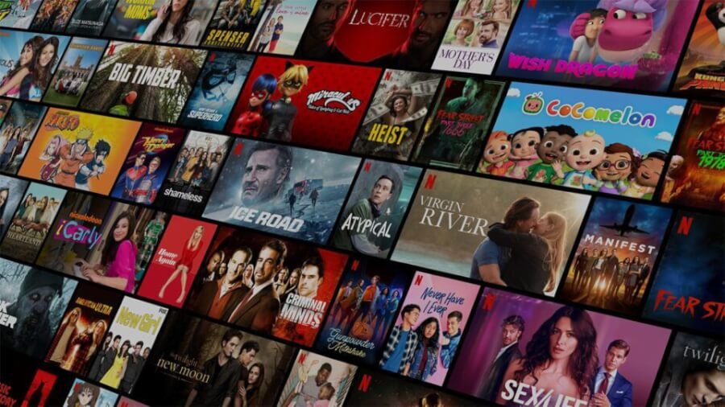
Content:
Introduction
Project Summary
Problem Statement
Data Description
Exploratory Data Analysis
Data Preprocessing
Model Implementation
Cluster Analysis
Conclusions

Slide 3
Introduction
Netflix, co-founded by Reed Hastings and Marc Randolph in 1997, is a renowned American media services provider.
Initially operating as a DVD rental-by-mail service, Netflix transitioned into an on-demand streaming platform, revolutionizing the entertainment industry.
Today, it offers a vast library of films, television series, and original content to subscribers worldwide. With 250 millions of users across the world, Netflix has significantly reshaped the way people consume entertainment, pioneering the shift from traditional cable television to streaming services. Its innovative approach to content creation and distribution has set industry standards and continues to shape the future of entertainment consumption.

Slide 4
Project Summary
"We systematically analyzed a Netflix dataset to uncover trends and group related information. Our approach involved:
1. Data Cleaning: Handling missing values, removing unnecessary columns, and converting categorical data to numerical formats.
2. Feature Extraction: Utilizing TF-IDF for text-to-numerical conversion, facilitating effective text clustering.
3. Dimensionality Reduction: Applying PCA to streamline data, aiding in efficient grouping and visualization.
4.Clustering: Experimenting with methods like K-means and agglomerative clustering. Evaluated using metrics like Davies-Bouldin Score and Silhouette Score.
5. Visualization: Creating scatter plots, word clouds, and 3D plots for cluster representation.
6. Evaluation: Assessing cluster quality via metrics like silhouette score and Calinski-Harabasz score.
In summary, our Netflix clustering project revealed hidden patterns, improving data classification and personalization. Further exploration of techniques and parameters is crucial for data-driven decisions in the entertainment industry."

Slide 5
Problem Statement
The aim is to do cluster analysis on a Netflix dataset in order to identify patterns and group similar items together. The collection contains a variety of information, including descriptions, actors, directors, types, and countries, among others. The goal is to find movie clusters based on these traits, which will allow for customized recommendations, targeted marketing, and content classification. The study aims to provide relevant insights about movie connections and to enable data-driven decision-making in the entertainment industry.

Slide 6
Data Description
There is 7787 rows and 12 columns in a dataset.
show_id : Unique ID for every Movie / Tv Show
type : Identifier - A Movie or TV Show
title : Title of the Movie / Tv Show
director : Director of the Movie
cast : Actors involved in the movie / show
country : Country where the movie / show was produced
date_added : Date it was added on Netflix
Release_year : Actual Release year of the movie / show
rating : TV Rating of the movie / show
duration : Total Duration - in minutes or number of seasons
listed_in : Genre
description: The Summary description

Slide 7
Data Preprocessing
● Director feature have more than 30.68% of null values. The null values were filled up with "Unknown".
● Country feature have 6.51% of null values. The null values were filled up with "Unknown".
● Cast feature have 9.22% of null values. The null values were filled up with "Unknown".
● Rating feature have 0.09% of null values. We removed the rows with null values.
● Date_added feature have 0.13% of null values. We removed the rows with null values.

Slide 8
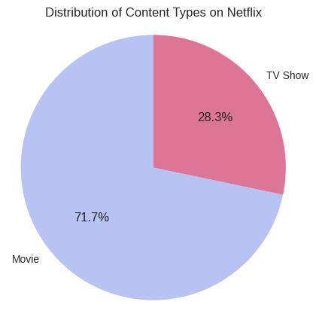
Exploratory Data Analysis
There are some EDA Chart which give us some insights of the data.
Distribution of Content Types on Netflix
There is two type of content available on Netflix.
•It is evident that there are more movies on Netflix than TV shows.
•Netflix has almost 72% movies and 28% TV Shows.

Slide 9
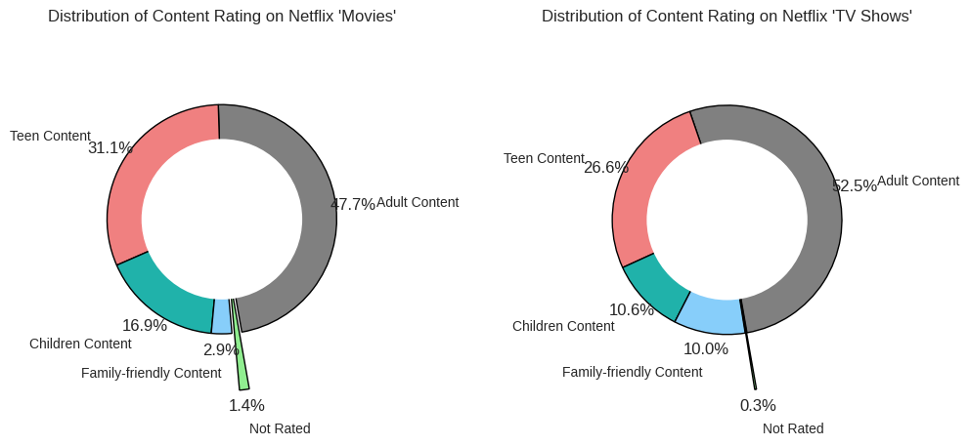
Distribution of content rating
Almost 50% content related to Adult category in both type
There is 31% content in movies and 26.6% content in shows related to “Teen Category”.
Approximately 20% content is related to other category in both type.

Slide 10
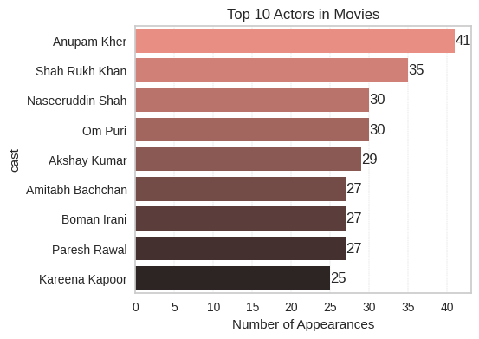
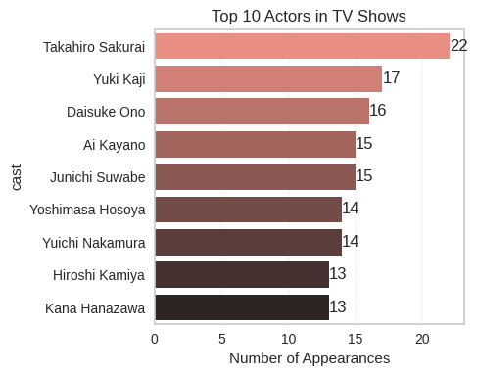
Top 10 performing actors
There is all top 10 actors in “Movies” are belongs to India. Where Anupam Kher is on the top with 41 Appearances.
“Takahiro Sakurai” is on the top with 22 appearances in TV shows category.

Slide 11
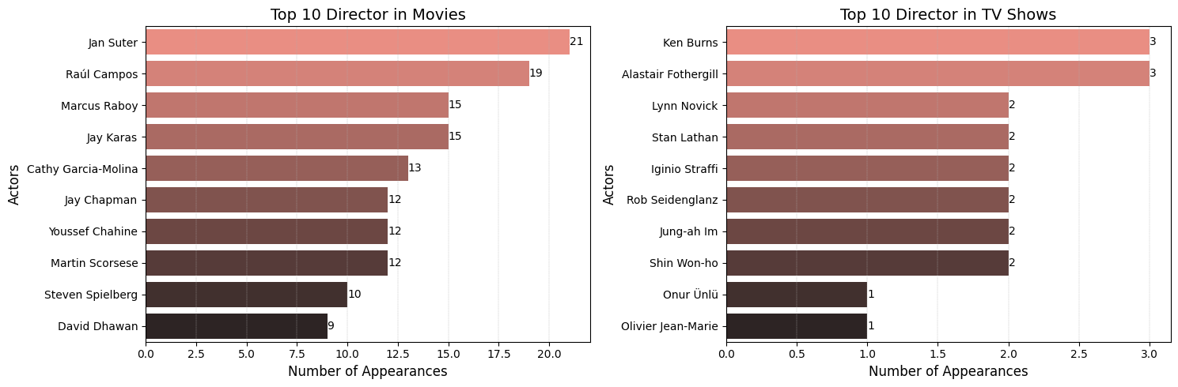
Top 10 Directors
We found that most of the movies directed by jan suter with 21 movies.
Most TV shows directed by ken burns with 3 TV shows.

Slide 12
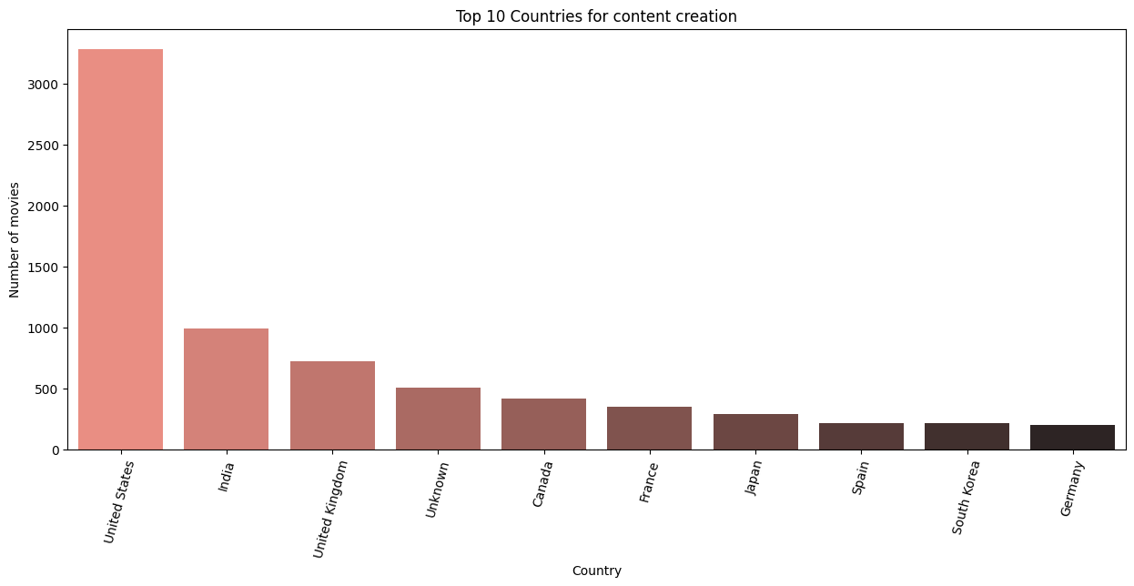
Top 10 content creation countries
“United States” is the top content producing country.
Where as India is on the second number in content producing country.

Slide 13
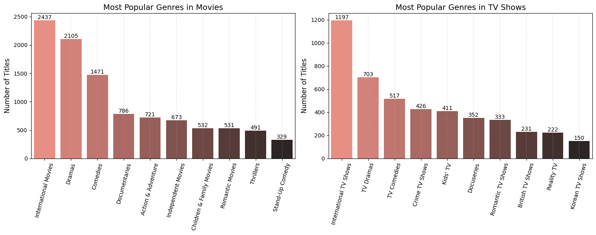
Top 10 Genres in both content
"International“, "Dramas“ and "Comedy" are the top three most popular genres in both movies and TV shows on Netflix.

Slide 14
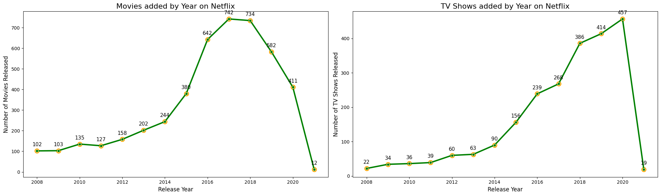
Content added on Netflix
Most movies and TV shows were added to Netflix between 2015 and 2020, indicating significant content growth during that period.
In 2017 the platform main focused to add movies a lot so in this year platform add highest movie.
In 2020, the most TV shows were added to Netflix, indicating a shift towards prioritizing TV series in that year.

Slide 15
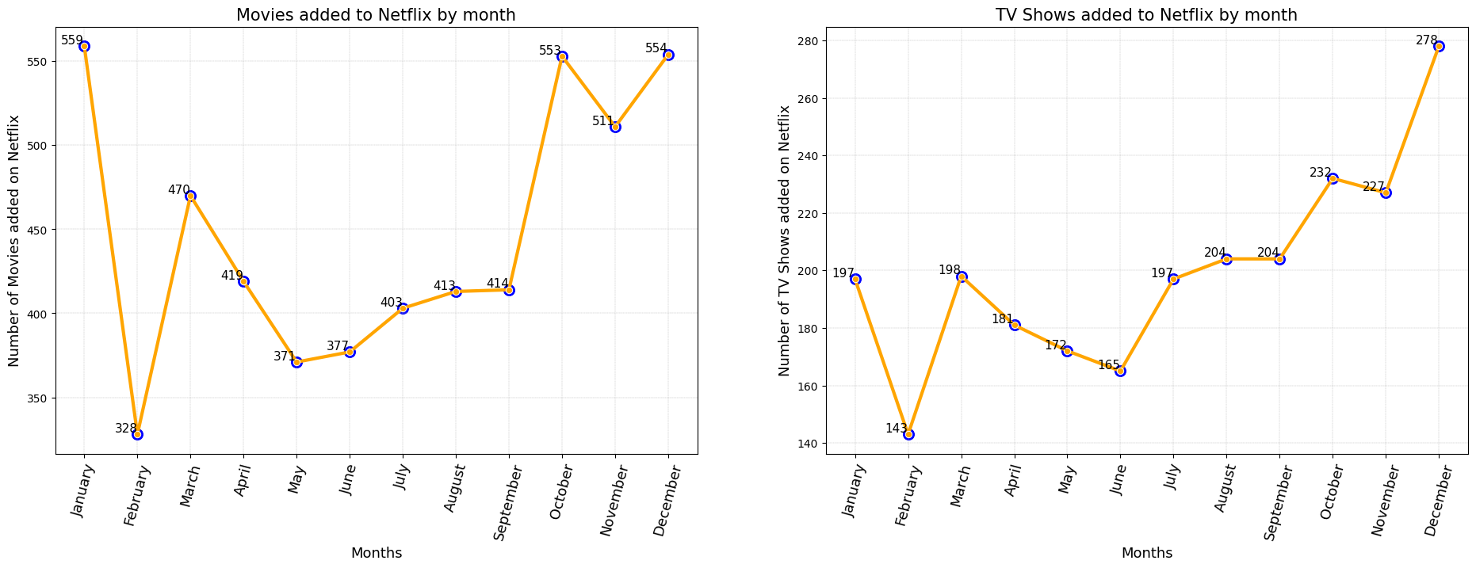
Content added on Netflix by months
We can see in this chart that most movies were added on Netflix in January and last quarter of last months of the year specially December.
Where as the month of January tops with 554 movies .

Slide 16
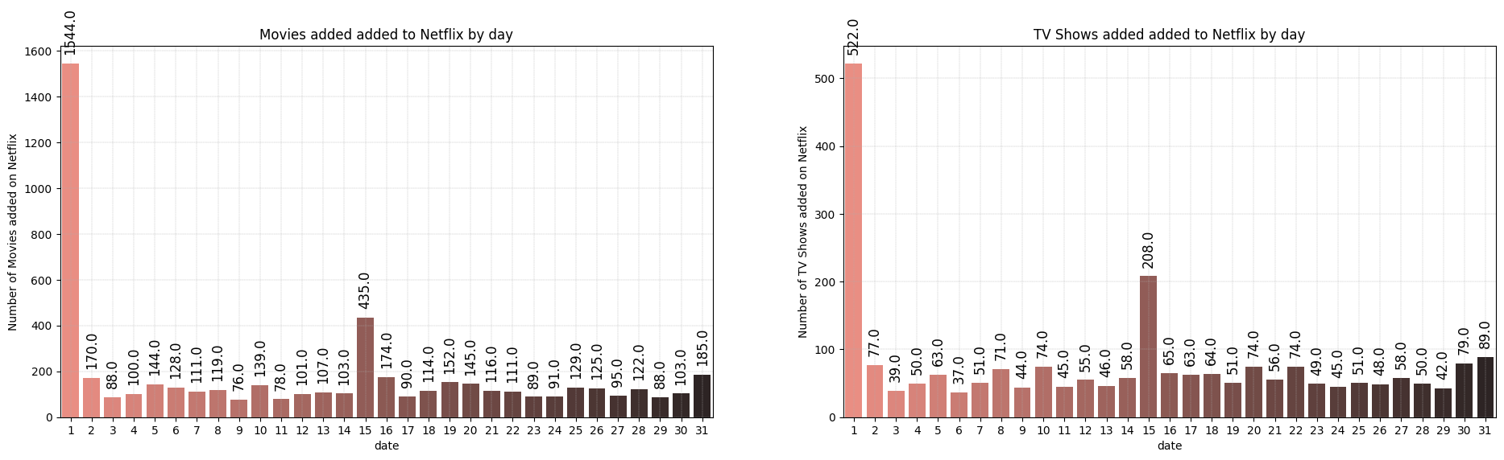
Content added date on Netflix
We found in this chart that, most of the content is added to Netflix on 1st and 15th date of the month.

Slide 17
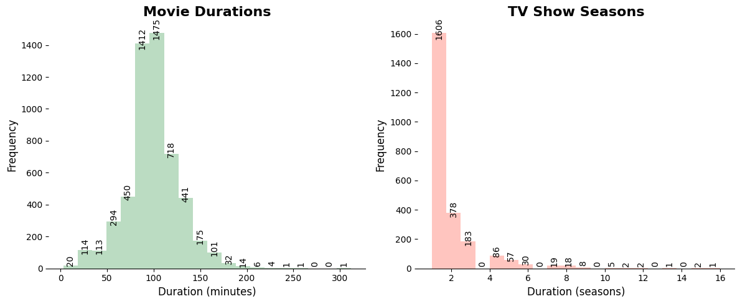
Duration of the contents
In movies we can see mostly movies duration is between 50 to 150 minutes range.
In tv show we can see mostly shows has only 1 season and only a few of them have more than one .

Slide 18
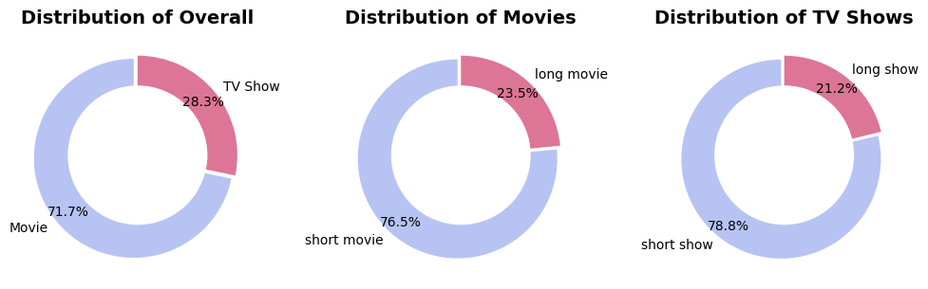
Content distribution based on duration
We have approximately 72% movies and 28% TV shows in the dataset.
In movies we have approximately 77% Short movies and 23% long movies in the dataset.
In Tv Shows we have approximately 79% short shows and only 21% shows are the short in the dataset.

Slide 19
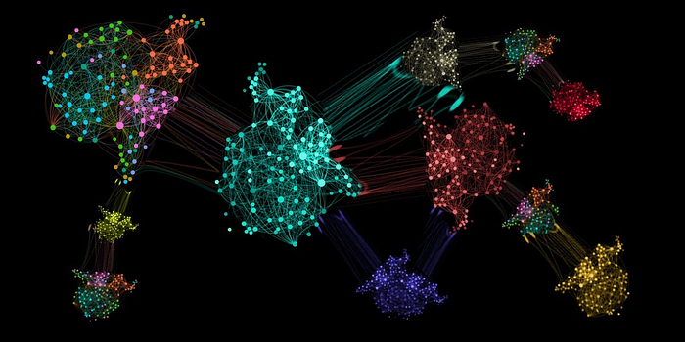
What is clustering?
Clustering is the process of grouping data points so that data points in the same group are more similar to other data points in the same group and different to data points in other groups. It is essentially a collection of items based on their similarity and dissimilarity.
We create one cluster column based on the following features:
• Director
• Cast
• Country
• Rating
• Listed in (genres)
• Description

Slide 20
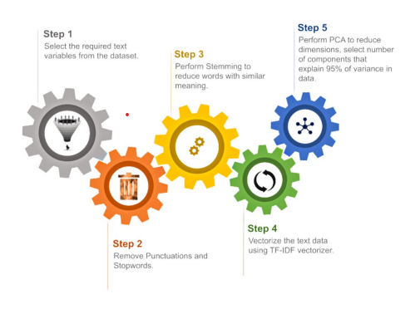
Data Preprocessing

Slide 21
Data Preprocessing Step
Before clusters implementation we need to pre-process the data. So that we filtered data with following steps:
1. Removing Stop words
• Stop words are common words like “the”, “and” and “but” do not carry much meaning on their own and are often seen as noise in the data.
2. Lowercasing words
• Lowercasing the words can also reduce the size of the vocabulary, which can make it easier to work with larger texts or texts in languages with a high number of inflected forms.
3. Removing Punctuation
• Punctuation marks like periods, commas, and exclamation points can add noise to the data and can sometimes be treated as separate tokens, which can affect the performance of NLP models.
4. Stemming
• used Snowball Stemmer to generate a meaningful word out of corpus of words.
• For example, the words "run," "runs," "ran," and "running" are all different inflected forms of the same word "run," and a stemmer can reduce them all to the base form "run."
5. Tokenization of corpus and Word vectorization – TFIDF
This is important in NLP tasks because most machine learning models expect numerical input and cannot work with raw text data directly. Word vectorization allows you to input the words into a machine learning model in a way that preserves the meaning and context of the words.
6. Dimensionality reduction – PCA
• Dimensionality reduction is the process of reducing the number of features or dimensions in a dataset while preserving as much information as possible. As high-dimensional datasets can be difficult to work with and can sometimes suffer from the curse of dimensionality.

Slide 22
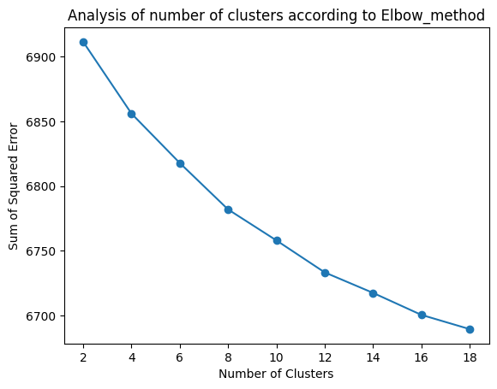
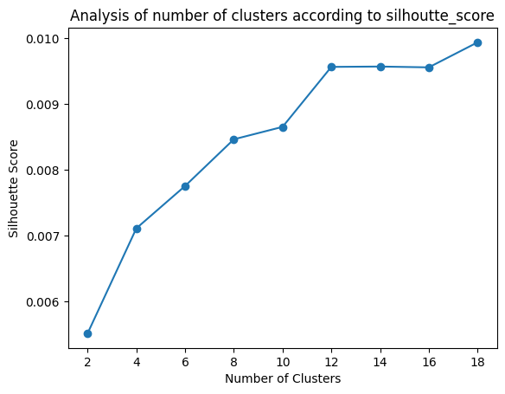
Model Implementation
k-means clustering
Visualizing the elbow curve and Silhouette score to decide on the optimal number of clusters for K-means clustering algorithm.
Using the Silhouette Score and Elbow Method we select the optimal number of clusters to be 9.

Slide 23
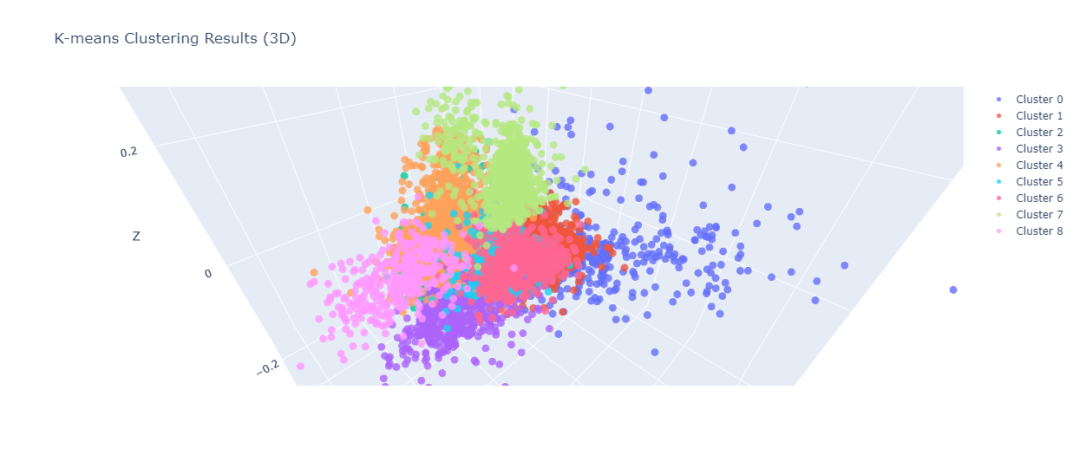
The numbers 0 to 8 represent 9-distinct clusters formed by K-means clustering.
Each cluster contains data points similar to those in the same groups but varies from other groups.

Slide 24
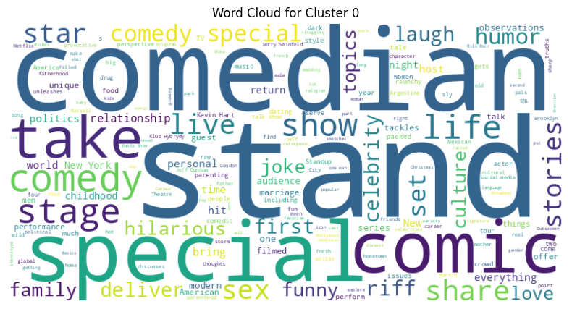
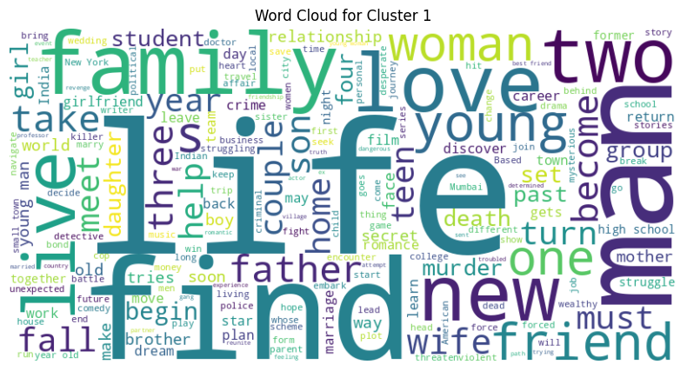
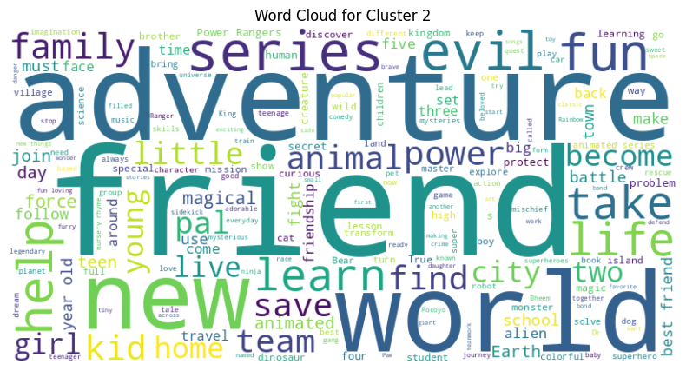
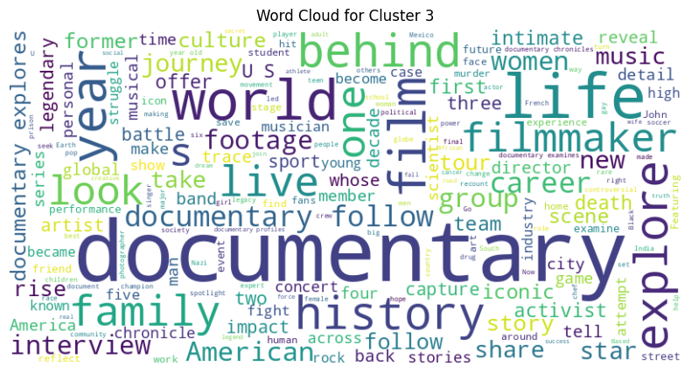
Data represented by each cluster
Stand-Up Comedy Show

Slide 25
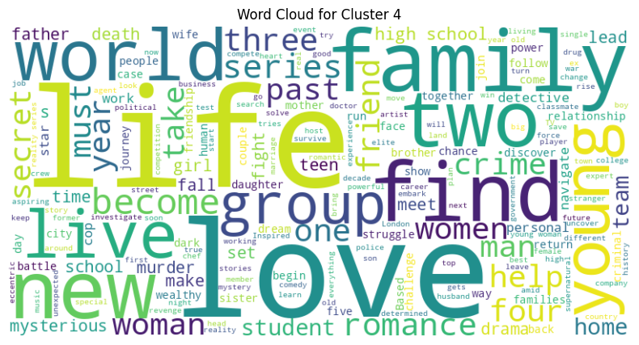
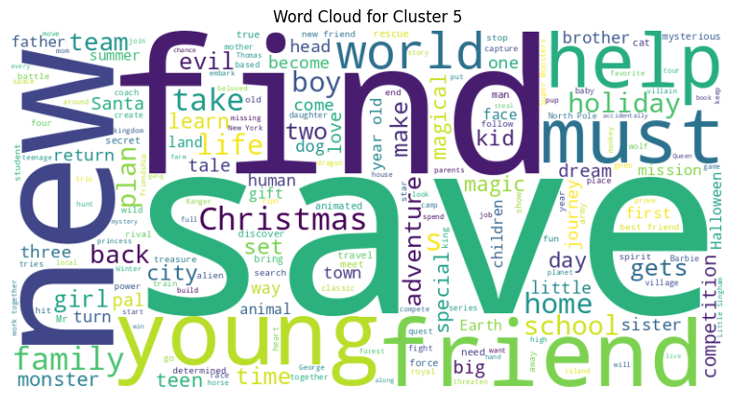
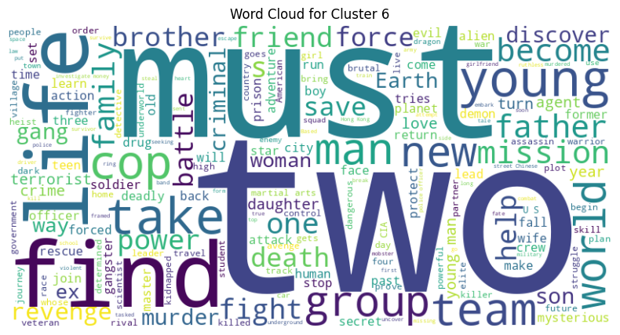
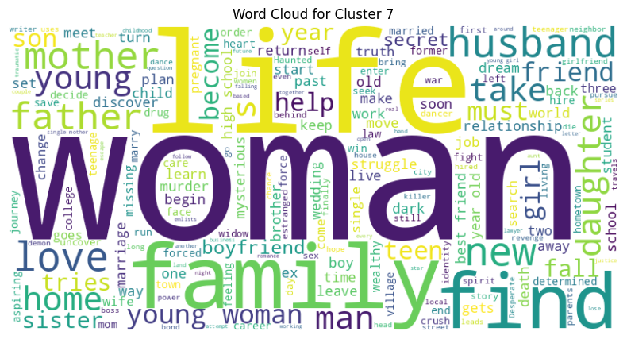

Slide 26
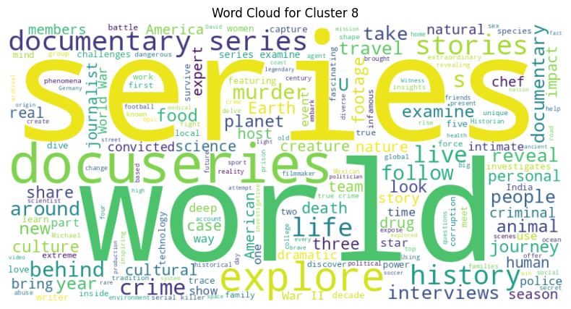
Data Represented by 8th cluster

Slide 27
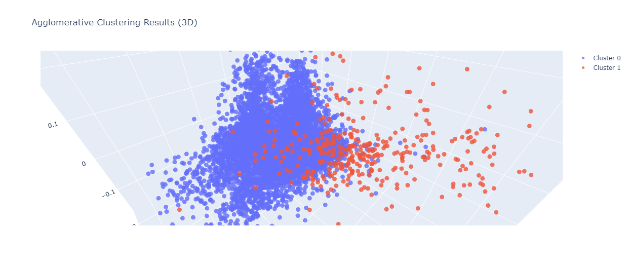
Agglomerative Hierarchical Clustering
The numbers 0 and 1 represent 2-distinct clusters formed by K-means clustering.
Each cluster contains data points similar to those in the same groups but varies from other groups.

Slide 28
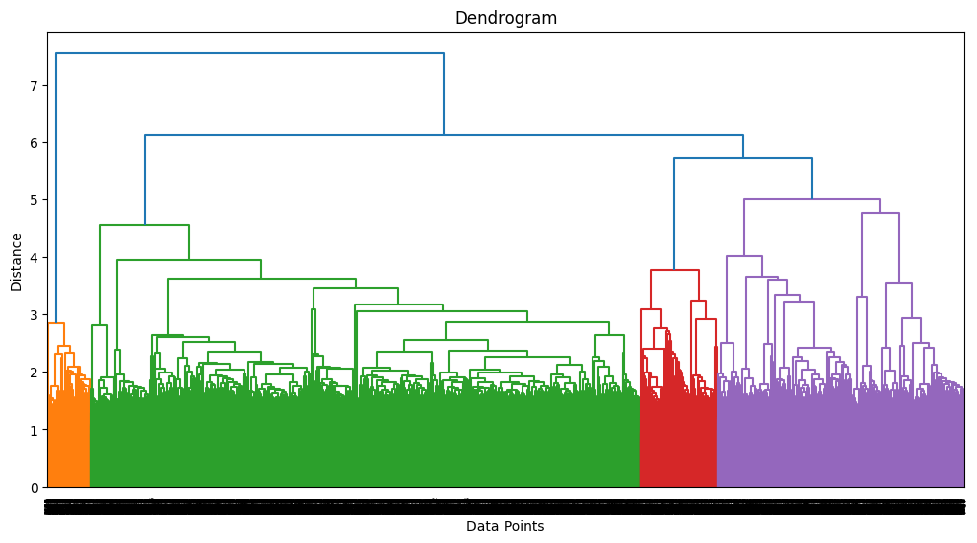
Agglomerative Hierarchical Clustering
• Visualizing the dendrogram to decide on the optimal number of clusters for the agglomerative (hierarchical) clustering algorithm.
• 2 clusters can be built using the agglomerative clustering algorithm.

Slide 29
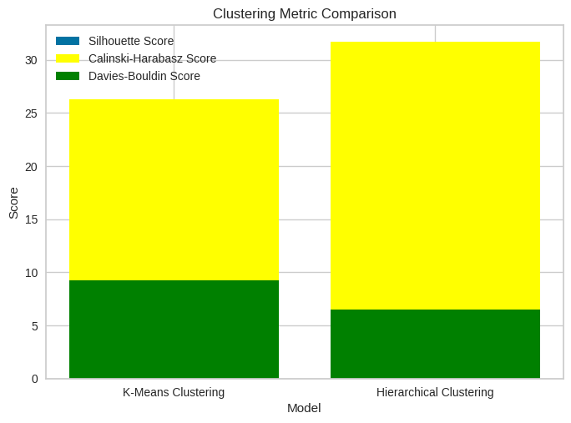
Final Prediction Model
Taking all of these assessment factors into consideration, Hierarchical Clustering appears as the best option. Its higher Calinski-Harabasz score implies stronger cluster separation, while its lower Davies-Bouldin score shows well-defined clusters with less overlap. While K-Means Clustering has a higher silhouette score, Hierarchical Clustering has a better overall performance.

Slide 30
Conclusion
Netflix's cluster analysis utilized unsupervised learning algorithms like K-means and Agglomerative clustering to group similar movies based on features like descriptions, cast members, directors, genres, and countries. The results provided valuable insights for personalized recommendations and targeted marketing strategies. The Silhouette Score, Calinski-Harabasz Score, and Davies-Bouldin Score assessed the clustering models' quality and effectiveness, contributing to data-driven decision making in the entertainment industry.
CONCLUSION FROM EDA:
Netflix has almost 72% movies and 28% TV Shows in his platform.
‘Adult’ is most popular genre on the platform with almost 50% share.
All top 10 appearance actors in movies belongs ‘India’.
‘Jan Sutar’ has directed the most movies and ‘Ken Burns’ has directed the most TV.
‘United States’ is the most content country where as ‘India’ is at the second place.
‘International’, ‘Dramas’ and ‘Comedy’ are the top three most popular genres in both movies and TV shows on Netflix.
Most of the movies added on Netflix in 2017 and TV shows in 2020.
Most of the content is added to Netflix on 1st and 15th date of the month.
Mostly movies duration range between 90 to 120 minute.
.

Slide 31
CONCLUSION FROM MODEL IMPLEMENTATION:
The data is clustered based on the attributes: director, cast, country, genre, rating, and description.
The TFIDF vectorizer was used to tokenize, preprocess, and vectorize the data in these attributes.
The data dimensionality, which formed the majority of the variation, was reduced using Principal Component Analysis (PCA).
The K-Means Clustering algorithm was used to create clusters, with 9 being the optimum number based on the elbow technique and Silhouette score analysis.
The agglomerative clustering technique was used to create clusters, with the dendrogram visualization indicating that 2 clusters were optimum.
Hierarchical Clustering has a better overall performance.

Slide 32


